Slide 1
Summer-Term TimeTable Generation
CSE7101- Capstone Project
Final Viva
Batch Number: COM_33
Under the Supervision of,
Dr. Sandeep Albert Mathias Assistant Professor
School of Computer Science and Engineering
Presidency University
Roll Number | Student Name
20221C0M0100 20221COM0108 20221COM0111 | Keerthi D V Vidya S Nishmitha K G
Name of the Program: Information Science and Engineering
Name of the HoD: Dr.Pallavi R
Name of the Program Project Coordinator: Mrs.J Benitha Christinal
Name of the School Project Coordinators: Dr. Sampath A K , Dr. Geetha A

Slide 2
Problem Statement Number: PSCS_399
Organization : Presidency University,Bengaluru
Category : Software
Problem Description : To automatically generate a conflict-free summer-term timetable by analyzing student course registrations, detecting course conflicts, grouping non-overlapping courses, and assigning each section a suitable time slot, faculty, and room.

Slide 3
Content
Problem Statement
Objectives of Project
Scope of Project
Analysis of Problem Statement
Git-hub Link
Timeline of the Project
Results and Discussion
References

Slide 4
Objectives
The primary objectives of the Summer-Term Timetable Generation System are:
To automate the timetable generation process by eliminating manual scheduling efforts and reducing human errors.
To ensure a clash-free timetable by detecting and resolving course overlaps based on student registrations.
To identify course conflicts using a graph-based approach and group non-conflicting subjects into suitable time slots.
To divide courses into sections based on student strength and assign faculty members to each section uniquely.
To allocate classrooms efficiently, ensuring no two sections share the same room during the same time slot.
To present the generated timetable in a user-friendly digital format using a web interface built with React.
To accommodate varying course enrollments and remove MOOC and low-registration courses to streamline scheduling complexity.

Slide 5
Scope of the Project
Reading course registration data from the dataset
Filtering out MOOC and low-enrollment (<21 students) courses
Identifying conflicts using student-course relationships
Grouping non-conflicting courses via greedy graph coloring
Assigning each group to fixed time slots (Monday–Friday, 9 AM–4 PM)
Automatically generating sections based on maximum capacity (60 students per section)
Assigning faculty and room numbers to each section
Displaying the final timetable through a responsive React-based web UI
Ensuring that no student has clashing classes

Slide 6
Analysis of Problem Statement
The problem is not just about placing courses into time slots; it involves:
Understanding student course patterns
Detecting shared enrollments and avoiding clashes
Managing finite resources (slots, faculty, rooms)
Automating section creation based on capacity
Producing a timetable that meets academic constraints
Therefore, the project requires algorithmic thinking (graph coloring), data structures (sets, dictionaries), and practical constraints, making it a real-world optimization and scheduling problem.

Slide 7
Analysis of Problem Statement (contd...)
Technology Stack Components:
1.Python (Backend / Processing Layer)
Reads the student registration data
Identifies conflicts between courses
Groups courses without clashes
Creates sections and assigns faculty and rooms
2.React.js (Frontend / Presentation Layer)
Displays the generated timetable in a clean table format on the browser
Allows the user to view timeslots, courses, rooms, and faculty details

Slide 8
3.Dataset File (Data Layer)
A text file that stores student course registrations
Used as input to generate the timetable
DATA (dataset.txt)
↓
PYTHON (generates timetable - backend logic)
↓
REACT (shows timetable - frontend UI)

Slide 9
Github Link
KeerthiGowdadv/Summer-Term-Timetable-Generation

Slide 10
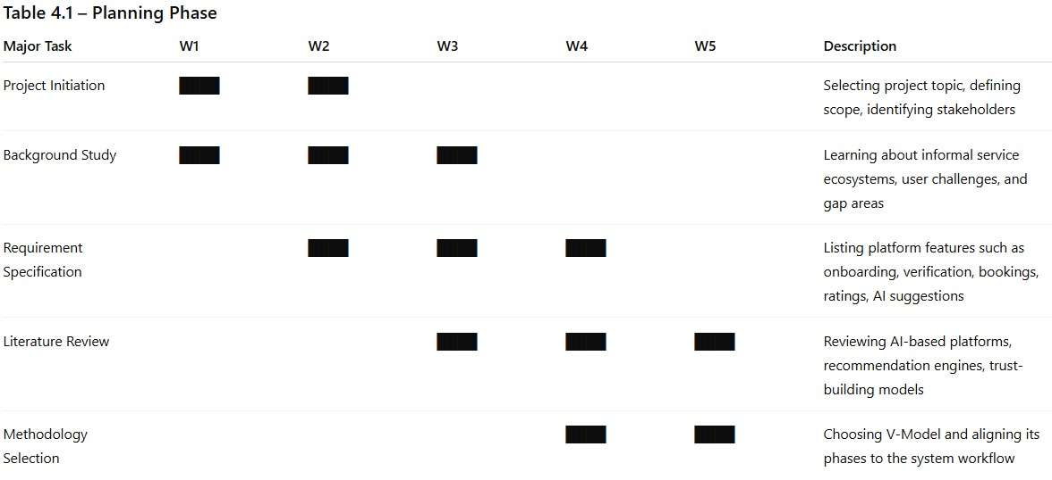
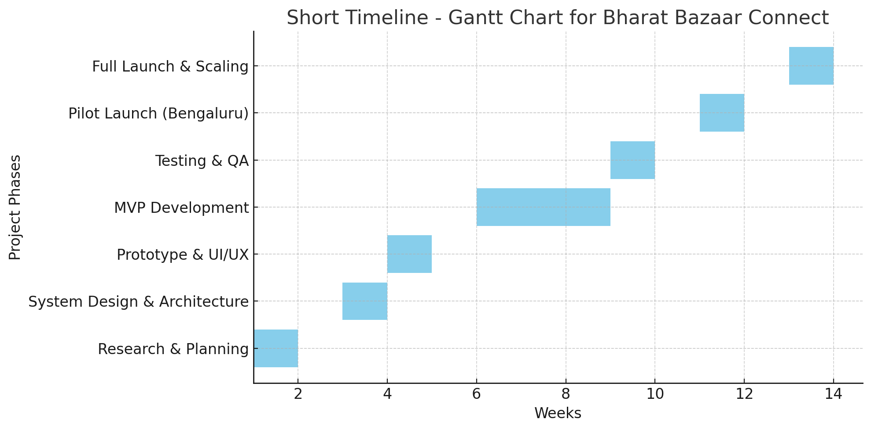
Timeline of the Project (Gantt Chart)

Slide 11
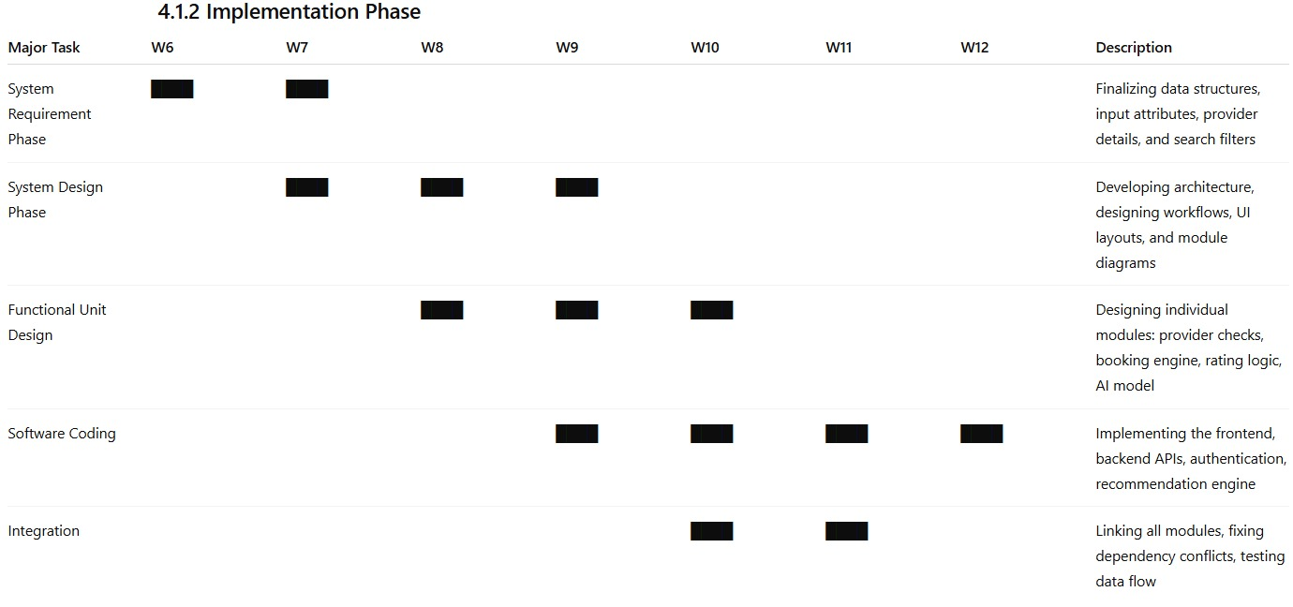

Slide 12
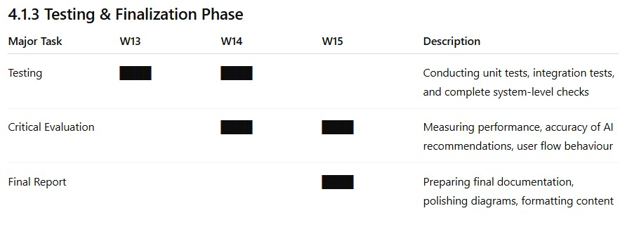
.

Slide 13
Result and Discussions
The system successfully generated a complete and clash-free summer-term timetable by analyzing student registrations, removing unwanted courses, identifying course conflicts, and assigning suitable time slots, rooms, and faculty. The output was displayed through a React-based interface, making the timetable easy to view and understand.
This project shows that automated timetable generation reduces manual effort, avoids errors, and ensures no student faces overlapping classes. However, the current system assumes fixed time slots and unlimited faculty availability. In the future, features such as faculty availability checks, lab scheduling, database integration, and PDF/Excel export options can be added to make the system more flexible and fully deployable.

Slide 14
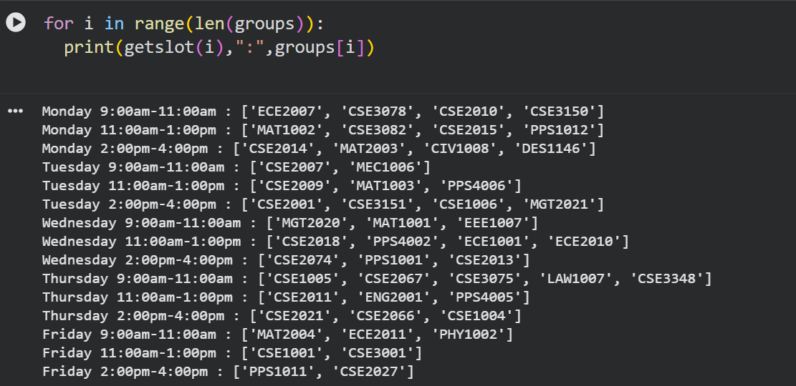

Slide 15
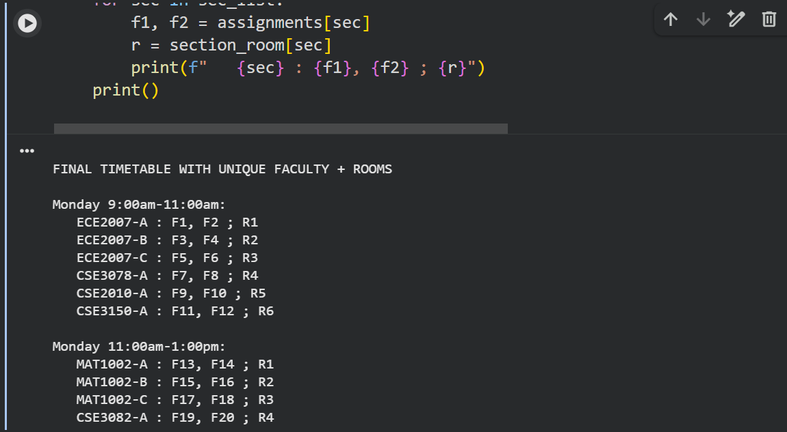

Slide 16
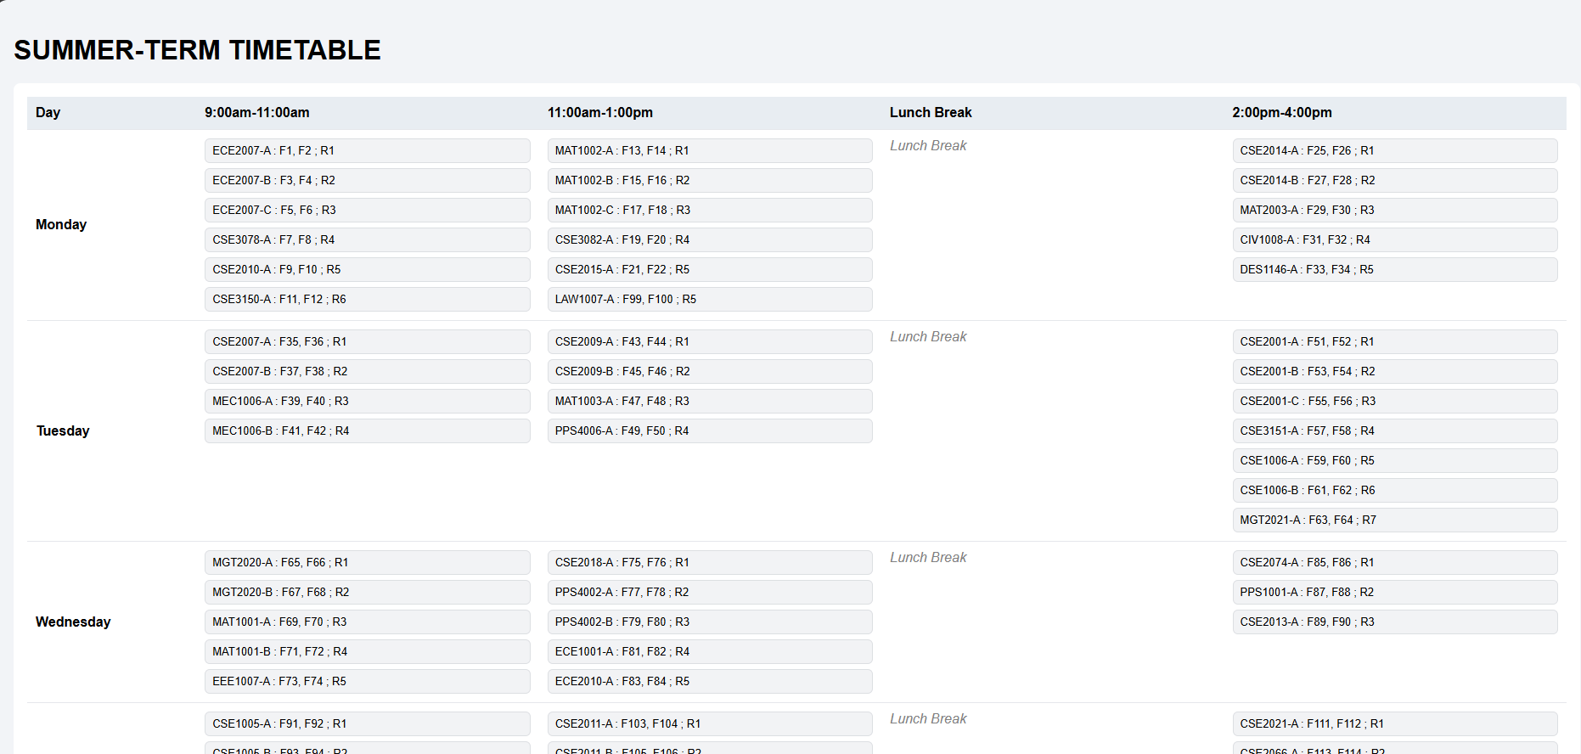

Slide 17
References (IEEE Paper format)
[1] Dasari, C.A., Kumar, S.M., Arpitalaxmi and Thushara, M.G., 2024. Optimizing University Time Table Schedules for Smart Space Utilization. IEEE GCAT 2024, Amrita Vishwa Vidyapeetham, India.
[2] Khokale, S.R., Jadhav, A., Chavan, R., Wani, S. and Iwanate, P., 2024. A Survey Paper on Timetable Generator Using AI Methods. IRJAEH Journal, Guru Gobind Singh College, Nashik, India.
[3] Kumar, S., et al., 2024. Adaptive Scheduler: AI Optimization of Academic Timetable. IJSDR Journal 2024, CMR Institute of Technology, Bengaluru, India.
[4] Indian Student Researchers, 2024. Automatic Timetable Generator. IARJSET Proceedings 2024, Indian Engineering College Authors.
[5] Indian Researchers, 2024. Automatic Timetable Generator using Genetic Algorithm. Atlantis Press 2024, Indian Academic Institutions.
[6] Kumar, A. and Sharma, P., 2023. University Course Timetable Scheduling using Metaheuristic Algorithms. IEEE ICACCS 2023, IIT Delhi, India.
[7] Teja, R. and Agarwal, N., 2025. AI-Driven Summer Term Timetable Generation for Higher Education. IEEE ICCES 2025, NIT Warangal, India.
[8] Patil, S. and Deepika, R., 2024. Automatic Timetable Generation using Genetic Algorithm in Indian Universities. IEEE ICECA 2024, Visvesvaraya Technological University, India.
[9] Karthik, M. and Verma, S., 2023. Smart Timetable Management System with Constraint Handling. IEEE ICICCS 2023, Anna University, India.
[10] Ahmed, S., Rahman, M. and Chowdhury, T., 2021. Automated timetable generation using graph colouring algorithms. International Journal of Computer Science and Information Security, 19(4), pp.45–53.
[11] Nandal, P., Satyawali, A., Sachdeva, D. and Tomar, A.S., 2021. Graph coloring based scheduling algorithm to automatically generate college course timetable. In 2021 11th International Conference on Cloud Computing, Data Science & Engineering (Confluence) (pp.210–214). IEEE.
[12] Sahoo, R. and Mohanty, B., 2022. Conflict-free scheduling using graph theoretic techniques. Journal of Applied Computing Research, 5(1), pp.1–12.
[13] Kumar, A. and Rout, N., 2020. Optimization of university course scheduling using greedy and heuristic techniques. ICCIKE 2020, pp.220–226.
[14] Pressman, R.S. and Maxim, B.R., 2020. Software Engineering: A Practitioner’s Approach. 9th ed. McGraw-Hill.

Slide 18


